Slide 1
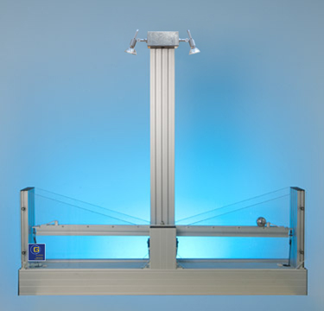
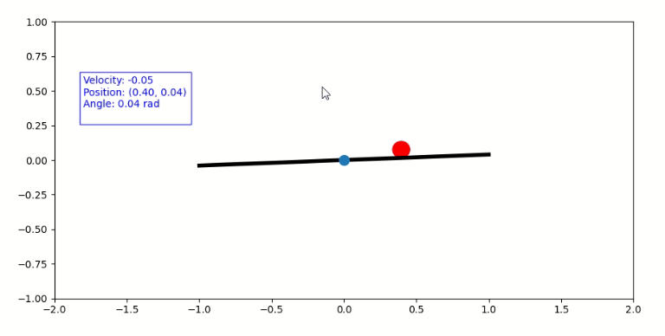
Hardware PC
RL Agent PC
Hardware Server
Dashboard Server
Hardware
Simulation
Motor file
Simulation
Camera file
RL Agent
Angle Measure
PID Controller

